Slide 1
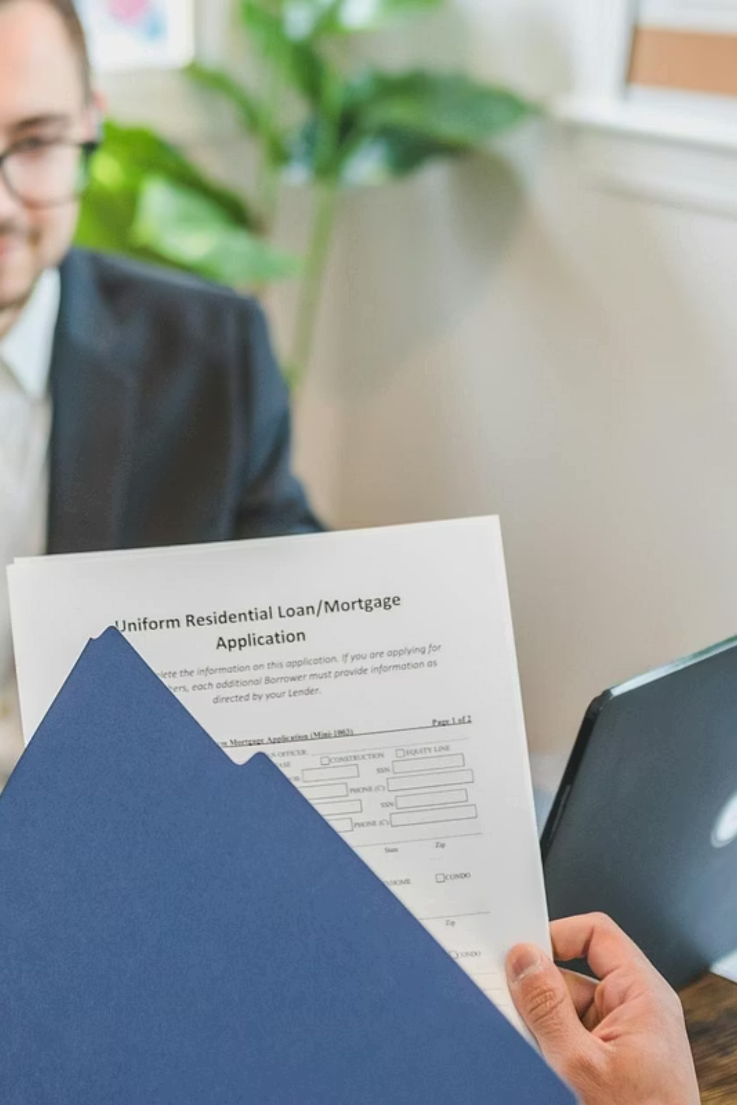
Commercial DSCR Loan Process Flow
A comprehensive operational guide for mortgage processing, underwriting, account management, and closing teams — establishing clear ownership, SLAs, and handoff protocols from broker submission through funded closing.
OPERATIONS GUIDE
COMMERCIAL DSCR
Purpose
Audience
Define clear process ownership, SLAs, and handoff triggers for every stage of the Commercial DSCR pipeline.
Setup, Underwriting, Account Management, Legal, and Closing teams operating on commercial DSCR files.
Scope
Covers broker submission through funded closing — including entity review, condo eligibility, and system automations.

Slide 2





Four-Stage Pipeline Overview
Every stage has a defined owner, hard SLA, and documented handoff trigger. No step advances without the prior stage's completion criteria being met.
Stage 1 — Loan Set Up
Stage 2 — Underwriting
Broker submits via Glide; Setup team indexes, validates, and prepares file for underwriting on Day 1.
Underwriter completes full credit, property, and entity analysis within 24 hours of receipt alert.
Stage 3 — Account Management
Stage 4 — Closing
AM manages conditions, LLC/Condo review, ordered reports, and borrower communication concurrently with underwriting.
Upon CTC, Closer is alerted immediately; closing package prepared with same-day priority; funded within 24 hours.
All four stages run under documented handoff protocols. Automated alerts notify AM, Underwriter, and AE simultaneously at key trigger points — no manual relay required.

Slide 3
CHAPTER 1
Stage 1
Loan Set Up
All files enter through a single submission channel. Setup owns Day 1 indexing, validation, and third-party ordering — triggering simultaneous alerts to the full processing team.
Owner
SLA
Handoff Trigger
Setup / Processor
Day 1 — Immediate upon submission
Automated alert to AM, Underwriter, and AE upon indexing completion

Slide 4

Broker Submission & Initial Intake
Submission Channel & Routing
Day 1 Alerts & Indexing
All loans enter via Glide — no alternative submission channels accepted under any circumstance
Consumer vs. Commercial routing: Identify loan type immediately upon submission to trigger the correct disclosure path
Commercial DSCR path: No Loan Estimate required; check for E-Consent received through Glide (condition if not present and move forward); verify Broker Fees received through Glide.
Credit Report: If Credit Report is not included, then automatically pull credit report. If credit report is expired, contact broker for updated or ask if Acra can repull new credit report.
Day 1 alerts: Upon indexing completion, automated alerts sent simultaneously to AM, Underwriter, and AE — no manual notification required
Offshore indexing: All documents indexed by offshore team; note any minimum docs not received or expired at time of indexing
Commercial DSCR files do not require a Loan Estimate. E-Consent may be conditioned rather than held as a hard stop — file moves forward while condition is outstanding.

Slide 5

Property, Credit & Third-Party Orders
SiteX Property Review
Pricer / Exceptions
Pull SiteX; review subject property details, usage type, and parcel number; input parcel number into system; flag any discrepancies for AM review before advancing.
Review pricer only for exceptions — standard pricing flows automatically from Glide. No manual comparison required for clean files.
Flood Certificate
3rd Party Tax Certificate
Auto-pulled via system integration. If manual research is needed, create a follow-up task and note; enter info and clear task upon receipt.
Order through DataTree only — title tax certs are not acceptable substitutes. Document DataTree order confirmation in processing log without exception.
Credit Report
Appraisal
If received from broker, order a reissue. If not received, order a new report directly. Confirm permissible purpose prior to ordering in all cases.
If received, update appraisal information screen and create task for valuation review. If not yet received, create follow-up task and note expected receipt date.

Slide 6
Critical Validation Checklist
All six checks must be completed and documented in the processing log before the file advances to underwriting.
Minimum Docs Check
1
If not received: call Broker and email both Broker and AE. If not submitted within 24 hrs, send second notice. If still not received after second 24-hr window, notify of cancellation.
2
Duplicate SSN Check
Click "Duplicate SSN Check" on processing log. If duplicate found, ensure the other loan is withdrawn or declined and notification sent before proceeding.
Multi-Pack Flag
3
If loan is part of a portfolio, add all relevant info to processing log for downstream AM and Underwriter communication. Do not leave portfolio context undocumented.
4
Purchase Contract Review
Review for estimated close date ; record in system to align team SLAs and closing prep timelines with the contractual deadline.
5
NMLS Verification
Verify NMLS credentials via 4th page of the 1003, NMLS consumer access and Salesforce for both Broker and Broker's Loan Officer. Document verification result in processing log.
6*
*Refinance Only — Listing Check
Confirm subject property is not currently listed for sale via Redfin. Search property address through USPS for accuracy and standardization.

Slide 7
CHAPTER 1B
Stage 1B
Broker Communication & Escalation
When minimum documentation is not received at submission, a defined 48-hour outreach and escalation protocol governs all broker communication — creating a clear, defensible audit trail for every cancellation decision.
Owner
Total Window
Documentation Required
Loan Set Up
48 hours from initial outreach to 3rd business day cancellation notice .
All calls and emails logged in processing log with timestamps

Slide 8


Broker Outreach Protocol — Missing Documents
Step 1 — Initial Outreach
1
Loan Set Up calls Broker to indicate documents needed. Simultaneous email sent to both Broker and AE detailing specific requirements.
2
Step 2 — 24-Hour Window
If broker does not submit required documents within 24 hours of phone call and email, a second email notification is issued to both Broker ,AE and RSM.
Step 3 — Cancellation Notice
3
If no response after the second 24-hour window, Broker, AE and RSM are notified that the loan will be cancelled — creating a clear audit trail.
48-Hour Hard Stop: Total window from initial outreach to cancellation notice is on the third business day. No extensions without documented management approval.
Documentation requirement: All broker calls and emails must be logged in the processing log with timestamps to support the cancellation decision if the file is later reviewed or escalated.

Slide 9
CHAPTER 2
Stage 2
Underwriting
Underwriting begins the moment the Day 1 alert is received. The Underwriter owns the full credit, property, and follow up entity analysis and must deliver a decision — with conditions — within 24 hours. Over-conditioning is an active risk to manage.
Owner
SLA
Handoff Trigger
Underwriter
Within 24 hrs of Day 1 alert receipt
CTC issued jointly by AM and Underwriter; Closer receives automated alert immediately

Slide 10


Underwriting — Day 1 SLA & Decision Flow
01
02
Alert Received
Underwriting Review
Setup indexes file; automated alert sent simultaneously to AM, Underwriter, and AE on Day 1. Underwriting clock starts immediately.
Underwriter completes full credit, income, property, and entity analysis; reviews DSCR calculations, LTV, title, and add all conditions within 24 hours.
03
04
Conditions Received
Decision Communication
Upon receipt of borrower conditions, alert goes immediately back to Underwriter for same-day review — no queuing, no delay in the conditions loop.
Email to Broker, AE, AM — from Underwriter. Thank for business, and showing decision with conditions. If there are any complicated conditions a phone call is expected from the underwriter.
05
Underwriter to indicate if pertinent docs are missing – NOIA letter – 10 days
⚠️ Over-conditioning risk: Refer to underwriting guidelines to ensure all conditions are material, specific, and required — not duplicative or unnecessary. Each condition issued represents a touchpoint that extends the timeline.

Slide 11

Underwriting: Key Review Steps
Core Underwriting Tasks
Secondary Review Items
Underwrite the Loan: Complete full underwriting following the DSCR process; review DSCR calculations, LTV, and all program eligibility criteria
DataVerify Review: Confirm where borrower lives; verify it matches the 1003; identify recent transfers of subject property; flag any recent foreclosures on personally owned properties
Appraisal Review: Review appraisal for subject property value, condition, and comparables; confirm valuation supports LTV requirements
LLC & Condo Check: Confirm LLC is listed as Borrower 1; review title to ensure no multiple transfers of property among LLC and guarantors.
DataVerify is the primary tool for identifying residence mismatches and recent property transfer activity — use findings proactively to reduce unnecessary conditions.

Slide 12
CHAPTER 3
Stage 3
Account Management
AM work begins on Day 1 — concurrent with underwriting, not after it. The AM owns broker communication, all ordered reports, LLC and condo review routing, and conditions management through to CTC.
Owner
SLA
Key Output
AM / Asst. AM
Day 1 — Concurrent with Underwriting
Ensure all third-party reports are ordered, entity/condo docs routed, conditions tracked, closing date established

Slide 13






AM Day 1 Concurrent Workstreams
AM is alerted simultaneously with the Underwriter upon file indexing. All six workstreams below are initiated on Day 1 — not after underwriting completes.
LLC / Entity Review
Condo Review
Immediately review file for all LLC, Corporation, or Trust documents; call Broker for missing docs; route complete docs to legal within 24 hours.
Review HOA documents, budget, litigation status, and owner-occupancy ratio against program guidelines; call Broker immediately for missing condo documentation.
Day 1 Ordered Reports
3rd Party Services
Credit Report (confirm or reissue), Lien/Judgment Report (all borrowers and entities), Flood Certificate (confirm auto-pull or order manually), Clear Capital AVM.
Ensure all third-party services have been ordered, received, and indexed appropriately before advancing the file.
CTC Issued​
Post-Underwrite Conditions
Work with Broker and AE to gather all conditions on a timely basis; establish the correct closing date aligned with purchase contract or product default.
Clear to Close call and email issued by AM to Broker and AE. Closer receives automated alert immediately to begin closing package.

Slide 14
Account Manager: Key Review Steps
Core Account Manager Tasks
Review file for LLC/Corp and Condo Review file for any entity requirements and ensure all documentation has been packaged and sent to Polunsky, Beitel and Green through Portal. Review if property is a condo and submit documentation need to Condo esk for review.
If documentation is not in file, immediately all broker and request needed items.
Third Party orders – Ensure all third party orders have been sent and follow up for receipt.
Condition Follow up – Continue to work with Underwriter, AE and Broker on collection of conditions.
Call Title/Closing Agent/Escrow - to confirm closing date and vesting and wire instructions.
Order Funding Shield – Account Manager upon receipt orders a Funding Shield Certificate confirming wire instructions.

Slide 15
CHAPTER 3B
Stage 3B
Entity & Condo Review
Entity and condo review are initiated by AM on Day 1 — concurrent with underwriting. Legal review of entity documentation carries its own 24-hour SLA from the moment AM forwards complete documents.
Entity Review Owner
Condo Review Owner
Fraud Guard
AM initiates; PB & G or Legal reviews within 24 hrs of receipt
AM / Asst. AM — concurrent with underwriting
All CPLs and Wire Instructions routed through Funding Shield Fraud Guard — no exceptions

Slide 16

LLC / Entity Review and Fraud Guard — Requirements
Required Documents
Legal Review SLA
Operating Agreement — confirms ownership structure and signatory authority
Articles of Organization — confirms legal formation of the entity
Certificate of Good Standing — confirms active status in state of formation
PB&G or Legal reviews entity docs within 24 hours of receipt from AM
AM must route complete documentation immediately upon set up completion — do not wait for underwriting decision
Funding Shield — Fraud Guard
All Closing Protection Letters (CPLs) and Wire Instructions go through Fraud Guard
Funders check certification data at closing — if differences found, re-run through Fraud Guard before authorizing wire
Ownership & Title Review
Identify authorized signatories and full ownership structure before routing to legal
Confirm LLC is listed as Borrower 1 on all loan documents
Review title to ensure no multiple transfers of property among LLC and guarantors
Wire instruction discrepancies must be re-cleared through Fraud Guard before any funding authorization is released. No exceptions to this requirement.

Slide 17


Condo Eligibility Review
1
2
Trigger
HOA Documents
AM conducts condo eligibility review concurrently with underwriting for all condo properties. Do not wait for underwriting to begin this review.
Review HOA documents, budget, and reserve fund adequacy against program guidelines. Flag any reserve shortfalls for underwriter review.
3
4
Litigation Status
Owner-Occupancy Ratio
Confirm no active or pending litigation against the HOA or condo association. Any litigation found must be escalated to underwriting immediately.
Verify ratio meets program guidelines. Document the ratio and the source used for verification in the processing log.
5
6
Missing Docs Protocol
Submission
Call Broker immediately for any missing condo documentation. Do not wait for the Underwriting decision to initiate outreach — early action protects the closing timeline.
AM or Asst. AM submits all LLC and/or Condo documentation to the appropriate department immediately upon set up completion.

Slide 18
CHAPTER 4
Stage 4
Closing
Closing is the highest-priority stage in the pipeline. Upon CTC, the Closer receives an automated alert and is expected to deliver same-day service. The hard SLA is 24 hours from CTC receipt to funding authorization.
Owner
SLA
Handoff Trigger
Closer
Same day preferred; hard maximum 24 hrs from CTC
Automated alert to Closer upon CTC issued jointly by AM and Underwriter

Slide 19

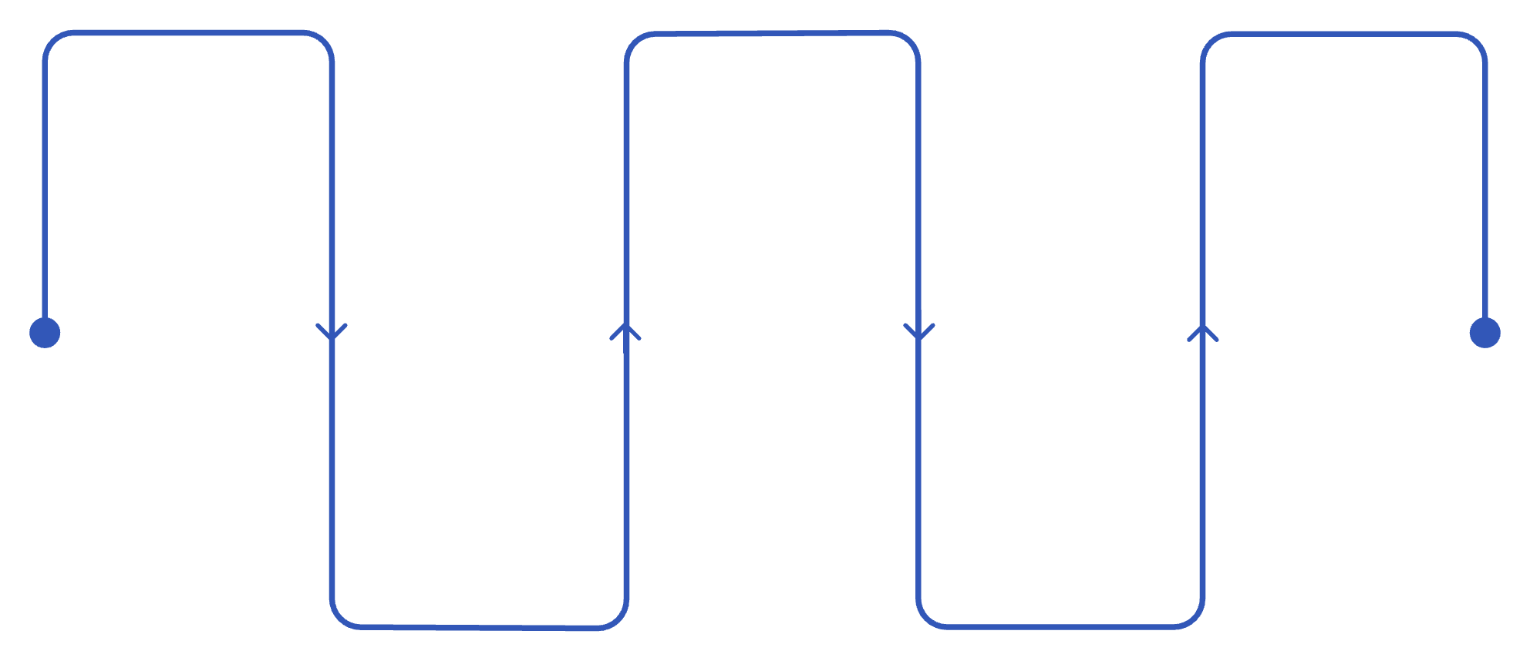
CTC to Funded — Closing Flow
CTC Issued
DataVerify Final
Funding Authorization
AM & Underwriter notify Broker/AE
Confirm no findings with final parties
Verify signed scans, label & authorize wire
Fee Verification
Document Draw
Reconcile fees; confirm Cash to Close
Generate docs per LOS Guide Byte Doc Drawer
Fee & Document Verification
Wet States — Wire Protocol
Balance fees with Broker, Title, and Closing Agent; confirm Cash to Close matches underwriting approval
DataVerify final check: ensure no new findings introduced by final parties added at closing
Draw documents per LOS Guide – Byte Doc Drawer Commercial v2.0
Wires ordered for Wet States and delivered with documents
Funding authorization released upon receipt of scanned signed documents and tracking number
Verify correct Acra Lending address for collateral receipt before authorizing shipment

Slide 20
CHAPTER 5
System Upgrades
& Process Changes
A suite of planned automations and process redesigns will reduce manual intervention, eliminate rework, and accelerate the pipeline at multiple stages. Time savings estimates are pending quantification with IT and Operations leadership.
Focus Area
Impact
Status
Automation of manual assignment, date entry, fee calculation, and third-party ordering
Reduced rework, fewer disclosure errors, and faster file advancement at intake
Time savings TBD — coordinate with IT and Operations before final rollout presentation

Slide 21





Planned System Automations
Auto-Assignment of Team Roles
Automated Estimated Closing Dates
System will automatically assign Asst. AM, AM, and AM Lead upon file receipt — mirroring existing Underwriting auto-assignment logic. Eliminates manual assignment delays and ensures no file sits unassigned at intake.
Refinances default to 30 days for all products; DSCR refinances default to 20 days — no manual entry required at intake. Eliminates a common source of date-entry errors that misalign team SLAs.
Automated PPP Fee Calculation
Automated Flood Certificate Pull
Prepayment Penalty fees automatically calculated and applied where applicable. Reduces manual review burden and potential fee disclosure errors in the closing package.
Flood certs automatically ordered and pulled at intake — eliminates manual vendor ordering in the majority of cases. Manual follow-up task only created when the auto-pull does not return a result.
⚠️ Time savings estimates for each automation item are pending — coordinate with IT and Operations leadership to quantify before final presentation to stakeholders.

Slide 22
Key Process Changes: What's Different
Eliminated Manual Steps
Policy & Scope Changes
No 1003-to-Byte Comparison: All loan data flows directly from Glide into the system; manual comparison eliminated — significant source of rework and delay removed (Time savings TBD)
Pricer Review — Exceptions Only: Standard pricing flows automatically; staff open pricer only when an exception exists and has been flagged (Time savings TBD)
Setup Orders Credit Report: If broker does not submit a credit report, Setup orders a new report directly; permissible purpose must be confirmed prior to ordering (Time savings TBD)
E-Consent for Commercial Loans: E-Consent can be conditioned if not received at Set Up; Loan Set Up adds condition prior to moving to Underwriting — file is not held
REO Scope Reduction: Working to reduce full REO requirement to Primary plus subject property only — no DTI requirement means full REO and mortgage histories on REO properties are unnecessary (in progress — working with Kyle)
DataVerify vs. Conditions: Use DataVerify report to confirm borrower residence, recent property transfers, and foreclosure history — reducing overall condition volume issued by Underwriting

Slide 23


Process Summary: Roles, Timelines & Ownership
All five roles operate under defined SLAs with documented handoff triggers. No stage advances without the prior stage's completion criteria being met.
Stage
Owner
Key Responsibilities
SLA
Loan Set Up
Setup / Processor
Index docs, validate NMLS, order flood/tax/credit, flag exceptions, duplicate SSN check
Day 1 – Immediate
Underwriting
Underwriter
Full DSCR credit, property, and entity analysis; issue decision with conditions
Within 24 hrs of alert
Account Management
AM / Asst. AM
Order reports, LLC/Condo review, conditions tracking, Broker/AE communication
Day 1 – Concurrent
Legal / Entity Review
Legal Team
Review and approve entity documentation forwarded by AM
Within 24 hrs of receipt
Closing
Closer
Prepare closing package, verify fees and DataVerify, draw docs, coordinate funding upon CTC
Same day; max 24 hrs
Reference guides: LOS Guide – Byte Underwriter Commercial v3.3 | LOS Guide – Byte Doc Drawer Commercial v2.0 | Funder Checklist

